Slide 1


STAT05
Discussion 1

Slide 2

Introduction
Shuangjie Zhang
Bayesian Statistics, Convergence of MCMC
szhan209@ucsc.edu
OH: Wed 9:00am-10:00am and 3:00pm-4:00pm
Homework: On Canvas
Discussion Materials: github.com/Zsj950708/STAT05-2020Summer

Slide 3

Chapter 1, 2 & 19
Discussion 1

Slide 4

Chapter 1 & 2
Randomized Experiment
vs.
Observational Study

Slide 5
randomization
In a randomized experiment researchers apply treatments to experimental units (people, animals, plots of land, etc.) and then proceed to observe the effect of the treatments on the experimental units.
In an observational study researchers observe subjects and measure variables of interest without assigning treatments to the subjects.

Slide 6
randomization
The biggest difference between randomized experiment and observational study is randomization.
Randomization is an impartial chance procedure is used to assign the subjects to treatment or control group. In observational study, the researchers did not assign people to groups. They are divided by some other features: such as their habits.

Slide 7
EXAMPLE 1
A study took random sample of adults and asked them about their bedtime habits. The data showed that people who drank a cup of tea before bedtime were more likely to go to sleep earlier than those who didn't drink tea.
Another study took a group of adults and randomly divided them into two groups. One group was told to drink tea every night for a week, while the other group was told not to drink tea that week.

Slide 8

Confounding - A major problem in observational study
A difference between the treatment group and control group-other than the treatment-which affects the response being studied.
A possible confounding factor (PCF) is a third variable, both associated with treatment variable and with outcome variable.

Slide 9
Example 2
An study has found that heavy smokers get lung cancer at higher rate than light smokers.
What is a possible confounder in this study?
Can researchers get the result that smoking will cause lung cancer?

Slide 10
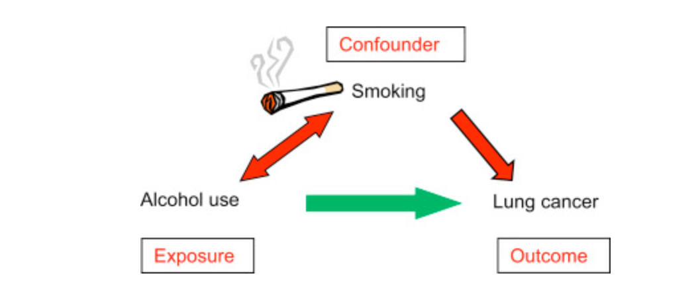
Confounder

Slide 11
Example 3
An observational study has found that heavy smokers get lung cancer at higher rate than light smokers; light smokers get the lung cancer at higher rates than non-smokers.
We know the fact that a gene that causes cancer but is unrelated to smoke. Is this gene a possible confounder?

Slide 12
Summary
Treatment Variable, Outcome variable
Treatment Group, control group
Randomized experiment vs. Observational Study
PCF (Definition, example)

Slide 13
Chapter 19
STAT 05

Slide 14
Sampling methods
Simple Random Sampling: drawing without replacement
Stratified Sampling: separating the population into non-overlapping groups called layer and then obtained SRS samples from each layer
Average age of all UCSC undergraduate students
Clustering Sampling: selecting all individuals within a randomly selected collection or group of individuals.
Spatial data
Systematic Sampling: selecting every kth individual from a population (or list)
Convenience Sampling : will have selection bias

Slide 15
SAMPLING bias
A systematic tendency on the part of the sampling procedure to exclude one kind of person or another from the sample
Any examples?
People from telephone books , club membership list, people encountered at a certain area
When a selection is biased, will taking a larger sample help?
This just repeats the basic mistake on a larger scale.

Slide 16
NON-response bias
NON-response bias
People did not respond to your survey or poll.
When there is a high non-response rate, look out for non-response bias.

Slide 17
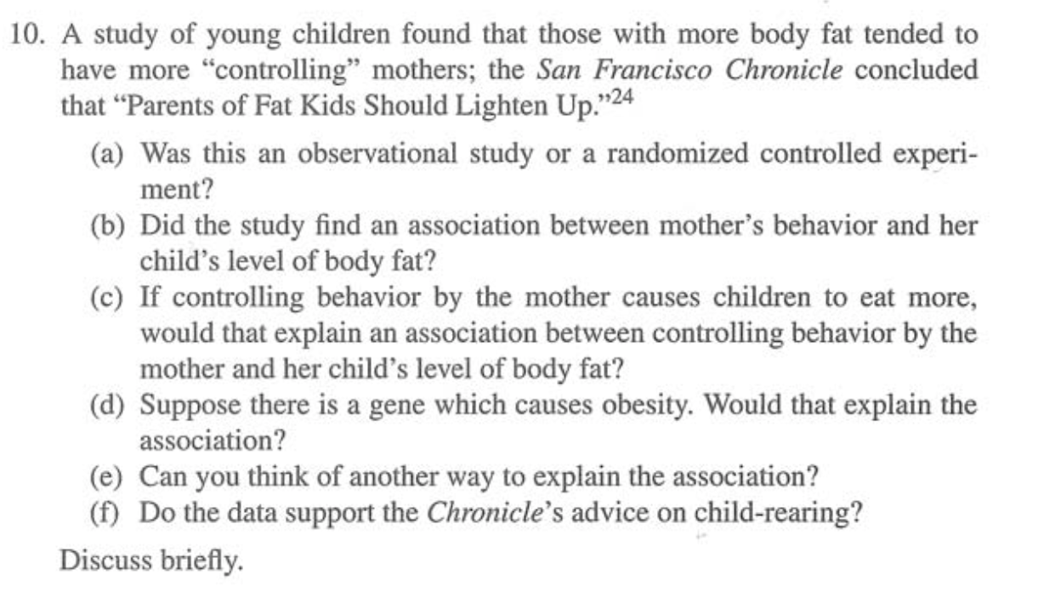
Homework question

Slide 18
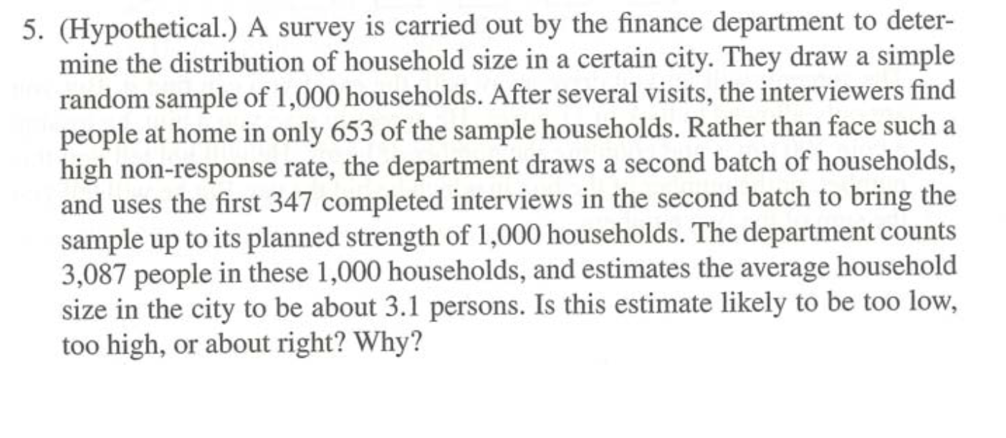
Homework question

